Slide 1
[Power BI Project – Data Analysis and Visualization]
NAME: CHERAN T
BATCH: DADS MARCH
DATE: 6-6-2025
Notes:
Be specific and direct in the title. Use the subtitle to give the specific context of the speech.
-The goal should be to capture the audience’s attention which can be done with a quote, a startling statistic, or fact. It is not necessary to include this attention getter on the slide.

Slide 2
Brief Intro and Dataset
Overview
Objective:
The goal of this project is to clean, transform, analyze, and visualize data using Power BI
To demonstrate your understanding of Power BI’s key features, such as Power Query Editor, DAX functions, and Dashboard creation,
Intro:
An interactive data visualization project that explores global trends in mental health disorders and behavior.
Focused on disorders like depression and alcohol use, across countries and years.
Also on Generosity, Life Ladder, Hale ,,etc.
Dataset:
Source: WHO / Global Health Dataset (Mental Health Indicators)
Notes:
The counterargument should be the most common argument against the topic. The goal for this slide is to address the counterargument in such a way as to actually strengthen the original topic. Be sure to address each piece of evidence against the topic. As you address each piece of evidence elaborate on the text found on the slide. Remember to transition to the final slide, the action step.

Slide 3
Data cleaning Process
Removed null or blank values.
Converted text-based numeric values to percentage.
Standardized column headers.
Filtered out inconsistent years or irrelevant entities.
Created calculated columns like:
High/Low classification (e.g., High_Alcohol_Us)
Great/Good/Not_Okay classification(e.g., life ladder)
Notes:
The counterargument should be the most common argument against the topic. The goal for this slide is to address the counterargument in such a way as to actually strengthen the original topic. Be sure to address each piece of evidence against the topic. As you address each piece of evidence elaborate on the text found on the slide. Remember to transition to the final slide, the action step.

Slide 4
DAX Functions Used
Measures:
Avg_Depression = AVERAGE('Table3'[Depression (%)])
Measure_count = DISTINCTCOUNT('World Happiness Report 2005-2021'[Country name])
Columns:
Measure_alcohol = CALCULATE(AVERAGE('Mental health Depression disorder Data'[Alcohol use disorders (%)]),'share-with-alcohol-and-substance-use-disorders 1990-2016'[Year]>=2000)
Other DAX Used:
ALL(), CALCULATE(), ROUND(), DATEADD()

Slide 5
DAX Measures and its formula
Measure_count = DISTINCTCOUNT('World Happiness Report 2005-2021'[Country name])
Measure_avg = AVERAGE('World Happiness Report 2005-2021'[Life Ladder])
Measure_alcohol = CALCULATE(AVERAGE('Mental health Depression disorder Data'[Alcohol use disorders (%)]),'share-with-alcohol-and-substance-use-disorders 1990-2016'[Year]>=2000)
Measure = CALCULATE(SUMX('Mental health Depression disorder Data',SUM('World Happiness Report 2005-2021'[Life Ladder])/SUM('World Happiness Report 2005-2021'[Healthy life expectancy at birth])))
Measure_life_ladder_&_hale = CALCULATE(SUMX('Mental health Depression disorder Data',SUM('World Happiness Report 2005-2021'[Life Ladder])/SUM('World Happiness Report 2005-2021'[Healthy life expectancy at birth])))
Time_Span_Covered = DISTINCTCOUNT('Table3'[Year])
Table_Measure:
Table_global = SUMMARIZE('World Happiness Report 2005-2021','World Happiness Report 2005-2021'[Country name],"avg of confidence of government",AVERAGE('World Happiness Report 2005-2021'[Confidence in national government]))

Slide 6
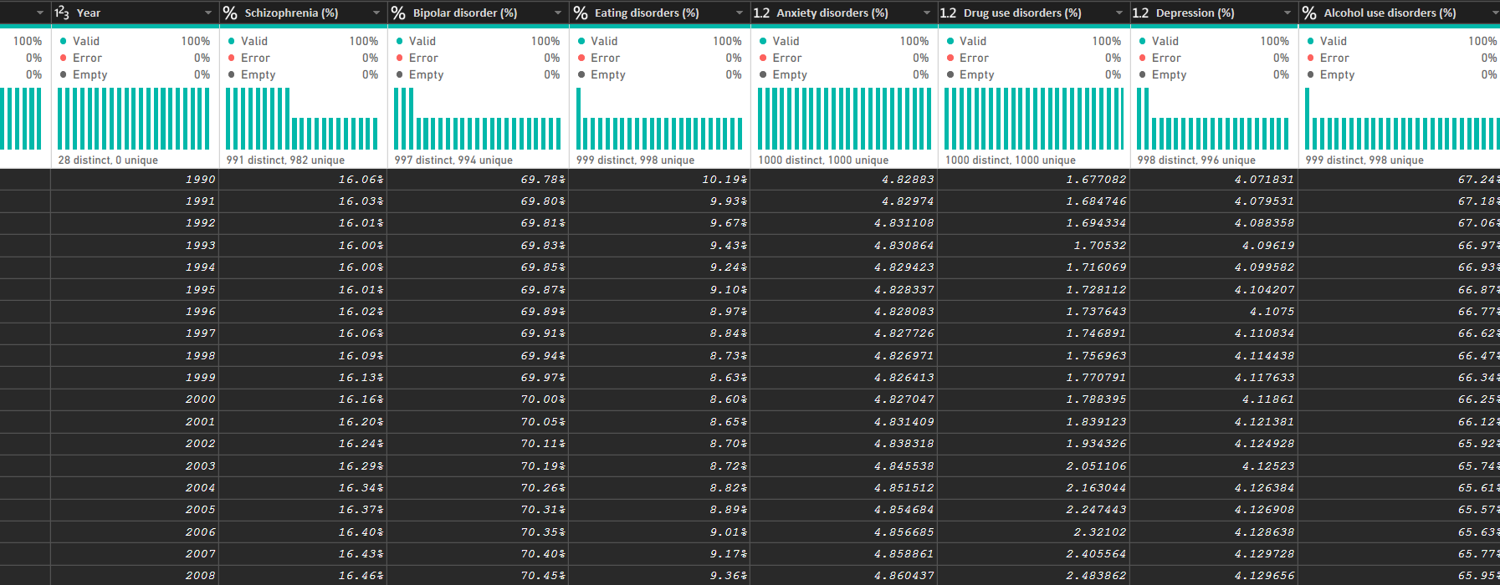
Dashboard Overview
After cleaning the data

Slide 7
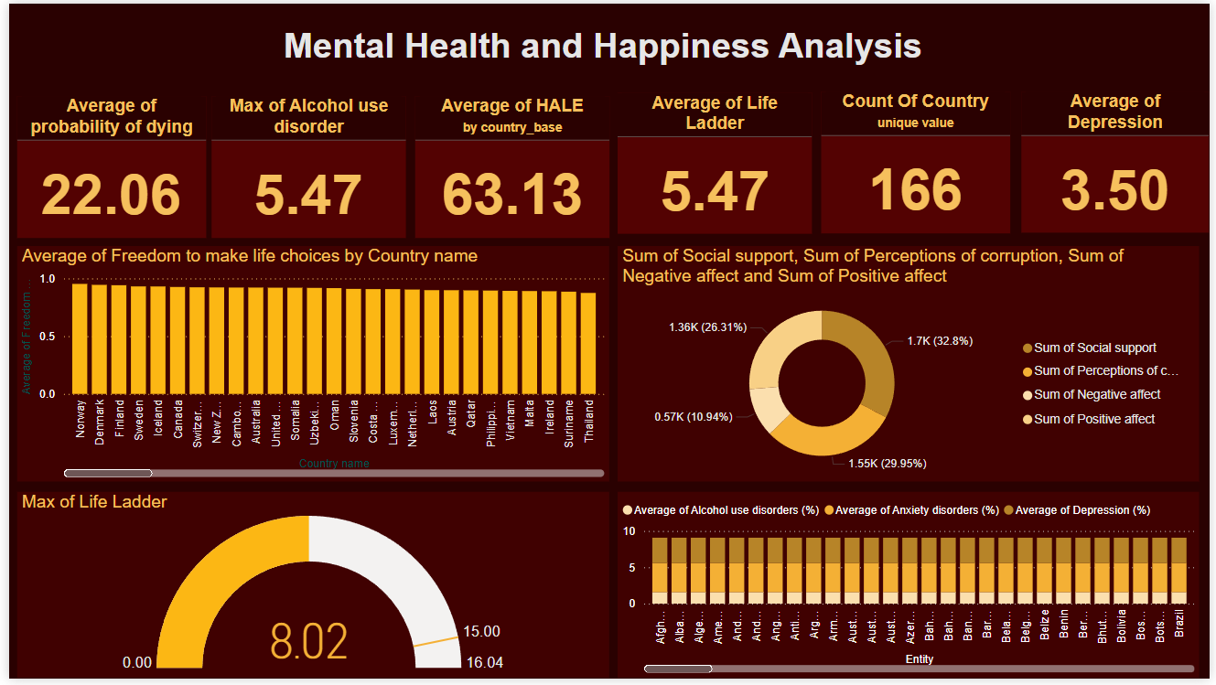
DASHBOARD

Slide 8
Findings and Insights
Key findings:
Depression and social isolation
Alcohol consumption and mental health
Happiness rankings and contributing factors
Insights:
Social connections enhance well-being
Alcohol’s complexity
Youth vulnerability

Slide 9
conclusion
global health datasets reveals intricate relationships between depression, alcohol consumption, and happiness.
While higher alcohol consumption correlates with increased happiness scores in some countries, it also aligns with rising mental health disorders, highlighting the complexity of these interdependencies.
Socio-economic and cultural factors further influence these dynamics, underscoring the need for comprehensive, multi-faceted approaches in public health strategies to address mental well-being and societal happiness.

